Slide 1
This week on amc’s the programmer
Keresztúri Péter
Github - Plonee

Slide 2
Who is this guy?
„You have pretty eyes!” Random drunk girl on Blaha
„Best player in Bronze V!” Rock Paper Shotgun
„So much #swag!”
Swag Weekly

Slide 3

Quick recap
Arrays
Methods
Lists
File.IO
WPF

Slide 4
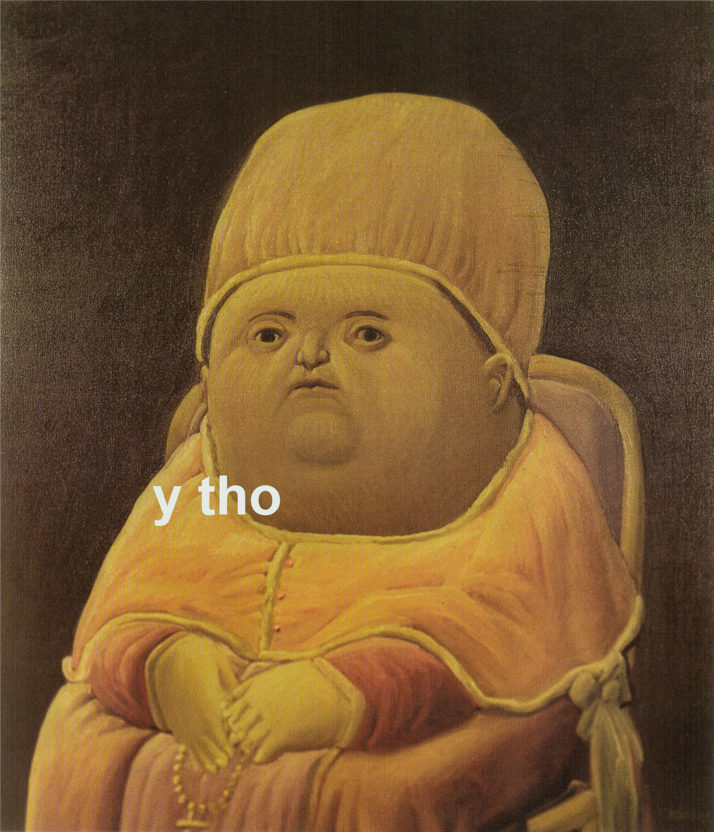
Arrays
Alex was like:
Don’t complicate the code

Slide 5
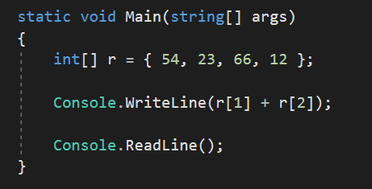
What I learned

Slide 6
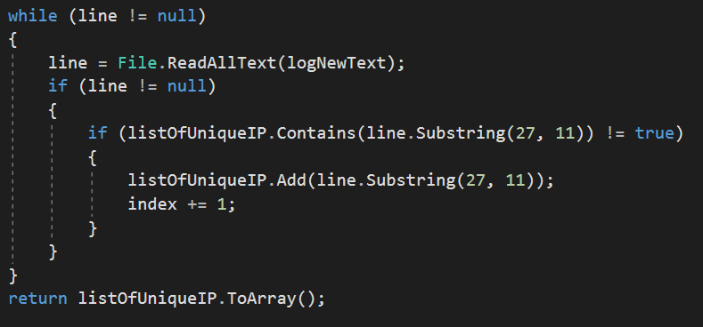
Log.txt

Slide 7
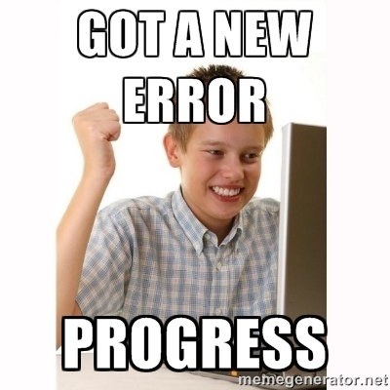
What i learned
Try to avoid tube vision
Don’t stress
Searh the web
Ask for help
Try to understand it as a whole

Slide 8
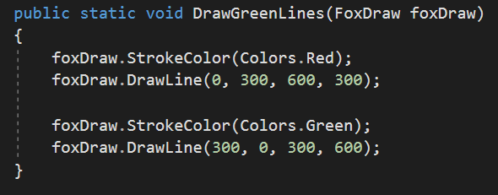
Drawing code

Slide 9
What i learned
Simple geometry
Logical thinking (kinda)
Drawing with code is hard :’(

Slide 10
Aims and goals for next week
Loops
Search more
Work alone
Know how to start the task

Slide 11
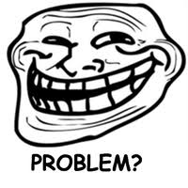
Thank you!
You thought it was over lol

